Slide 1
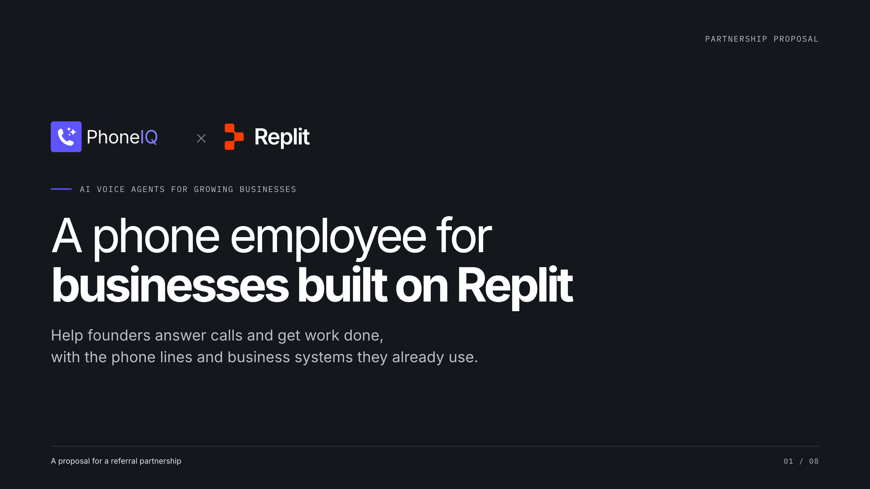
Notes:
[Sources]
- Saliba's partnership brief, supplied by Michael, 2026-10-01.
- https://www.phoneiq.co/brand-guide
- Phone employee is a metaphor for an AI voice agent; this is a proposed partnership, not an existing Replit relationship.

Slide 2
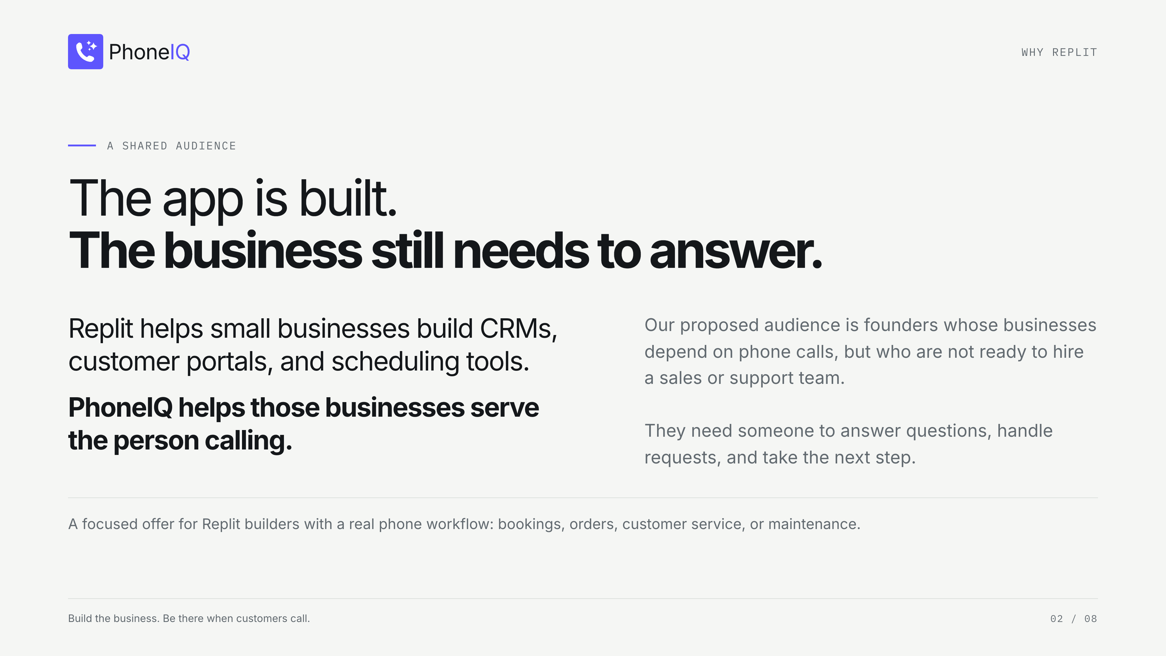
Notes:
[Sources]
- https://replit.com/usecases/smb (accessed 2026-10-01): custom CRM, customer portal and scheduling app use cases.
- https://replit.com/products/agent (accessed 2026-10-01): natural-language app building and integrations.
- Saliba's brief: founder staffing constraints are the proposed target segment, not a measured claim about all Replit users.

Slide 3
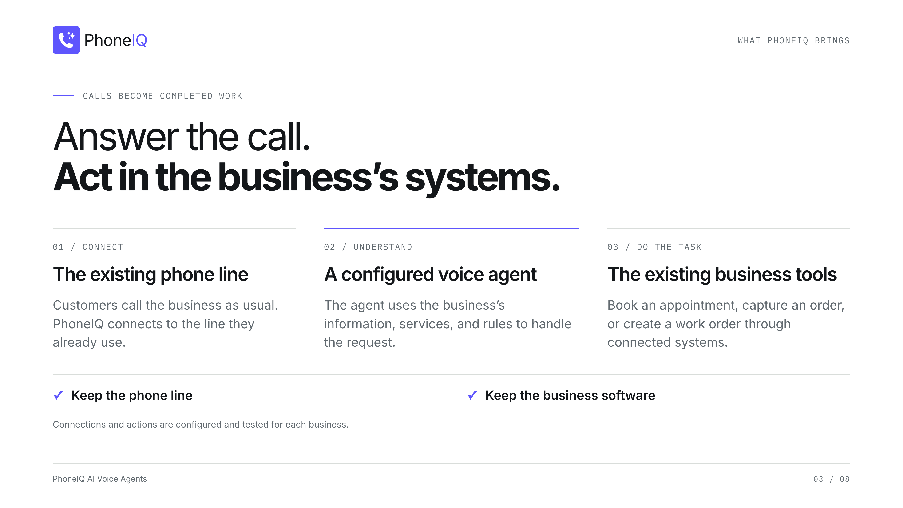
Notes:
[Sources]
- Saliba's brief: existing phone lines and information systems remain in place.
- https://www.phoneiq.co/ (accessed 2026-10-01): workflow configuration, business tools, number routing and testing.
- A Replit-specific native integration is not asserted. Supported actions depend on the business's connected systems.

Slide 4
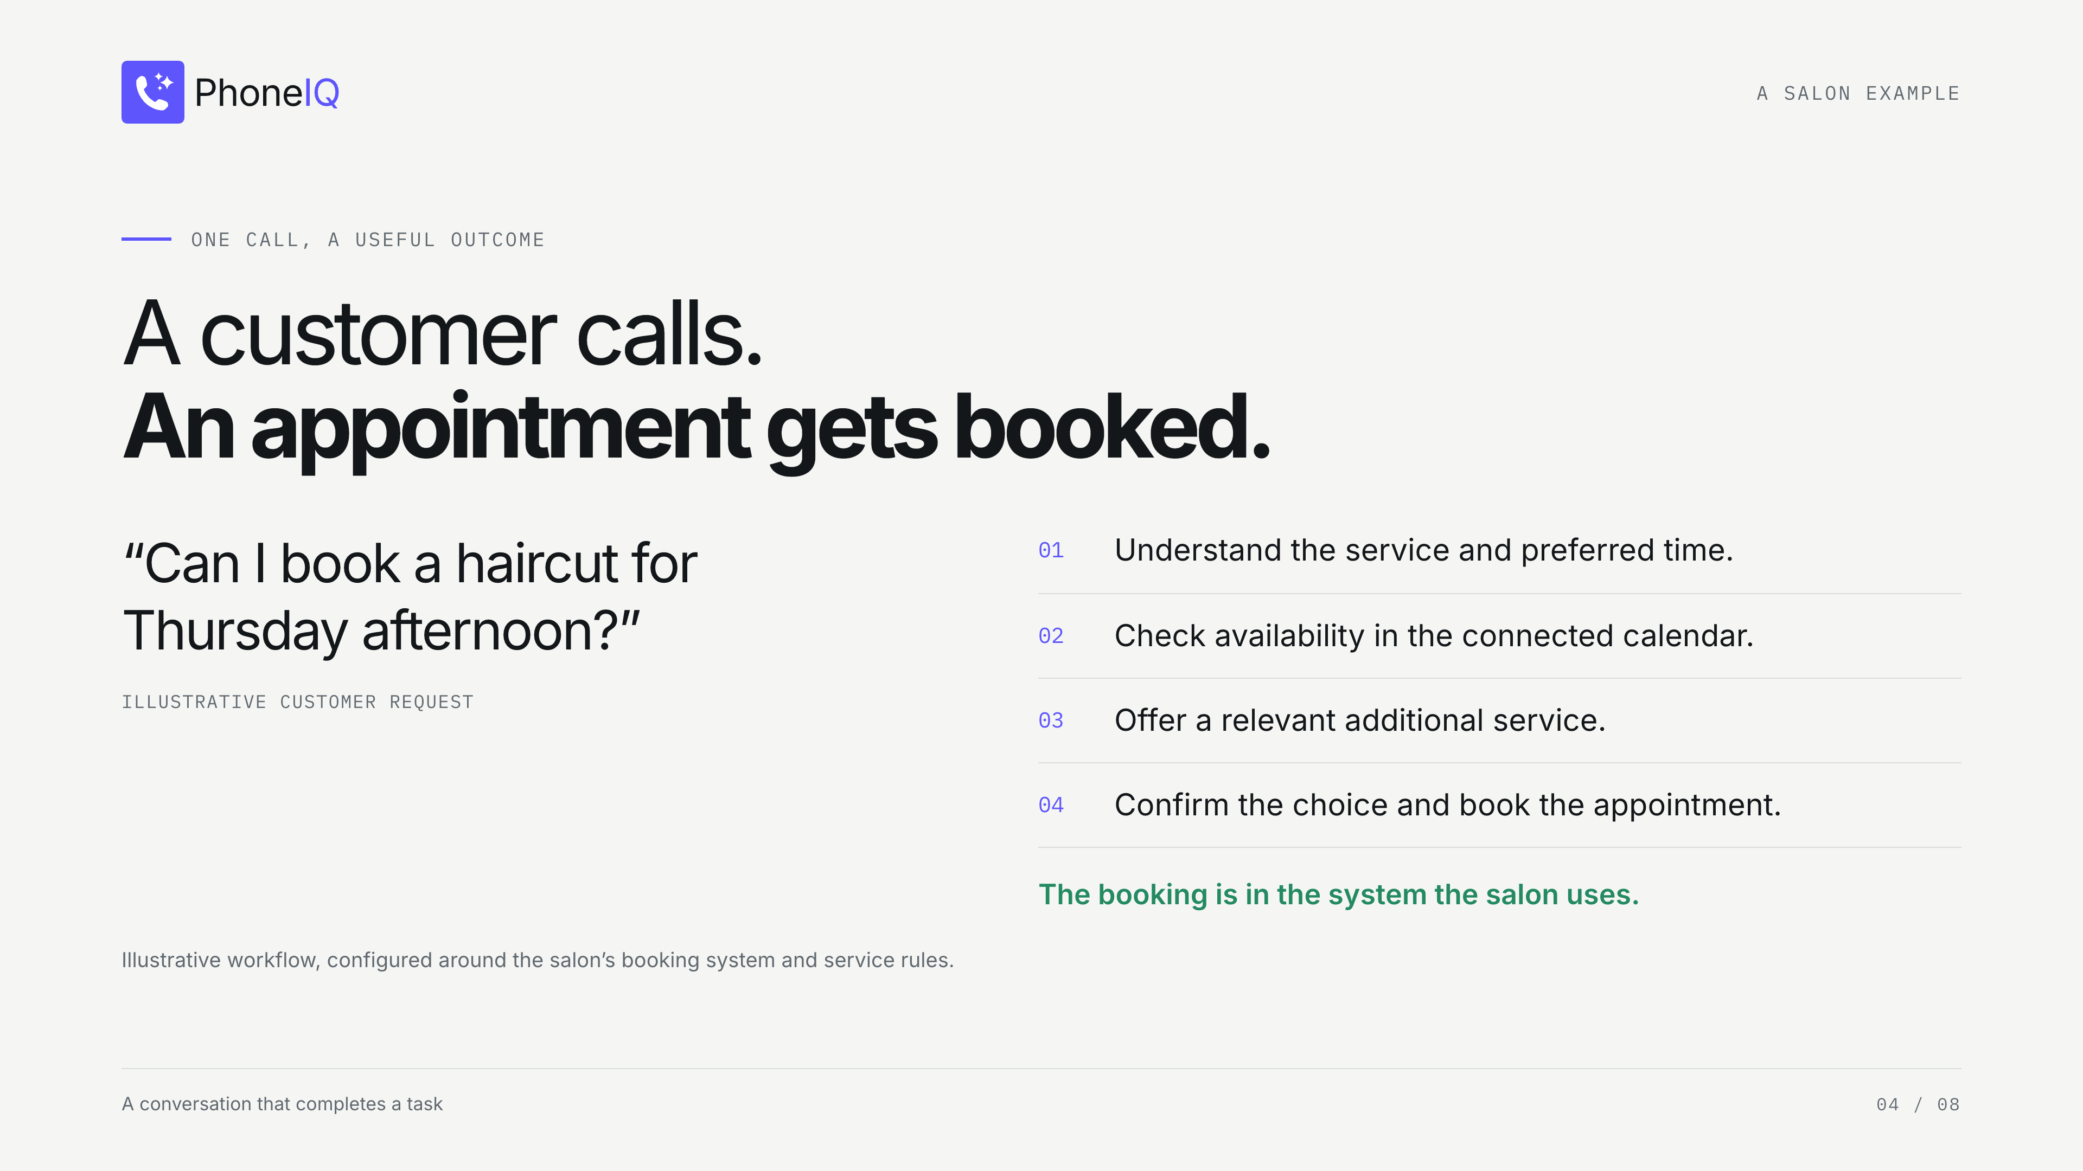
Notes:
[Sources]
- Saliba's brief: salon appointments, service upsells and business hours.
- https://www.phoneiq.co/ (accessed 2026-10-01): salon booking illustration.
- This example is illustrative, not a reported customer result or proven Replit integration.

Slide 5
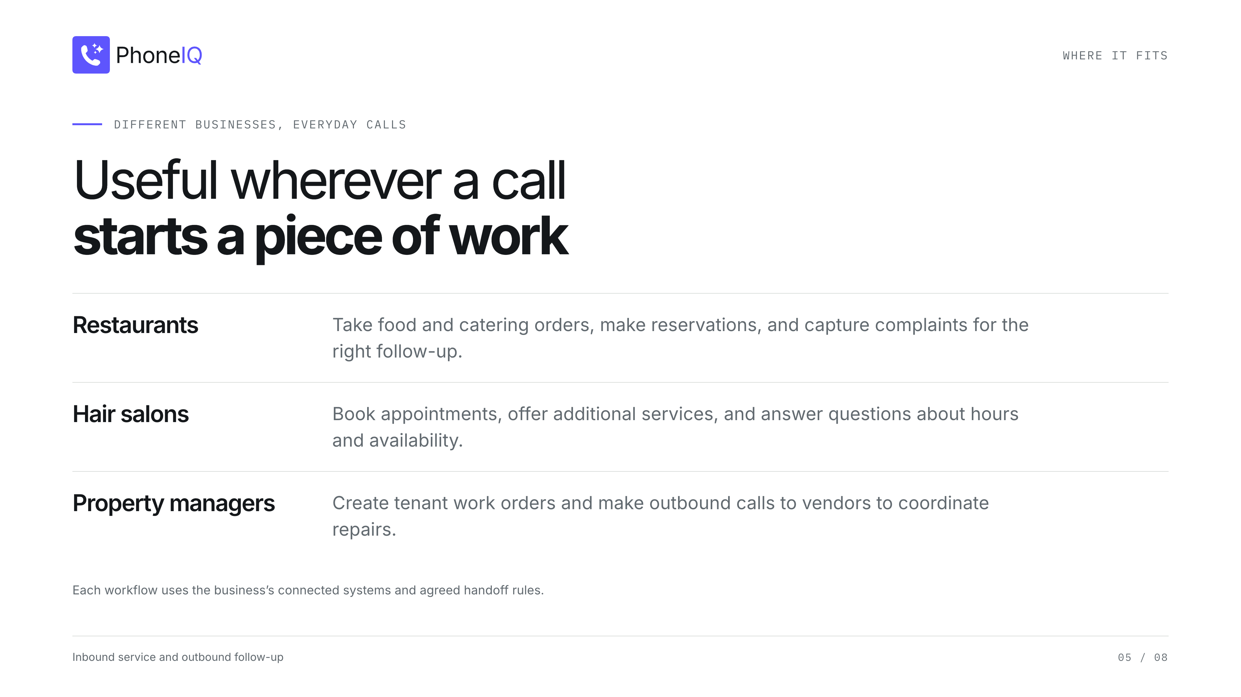
Notes:
[Sources]
- All three verticals and tasks come from Saliba's supplied partnership brief.
- These are use cases, not named customer deployments or a claim that every software integration is available.

Slide 6
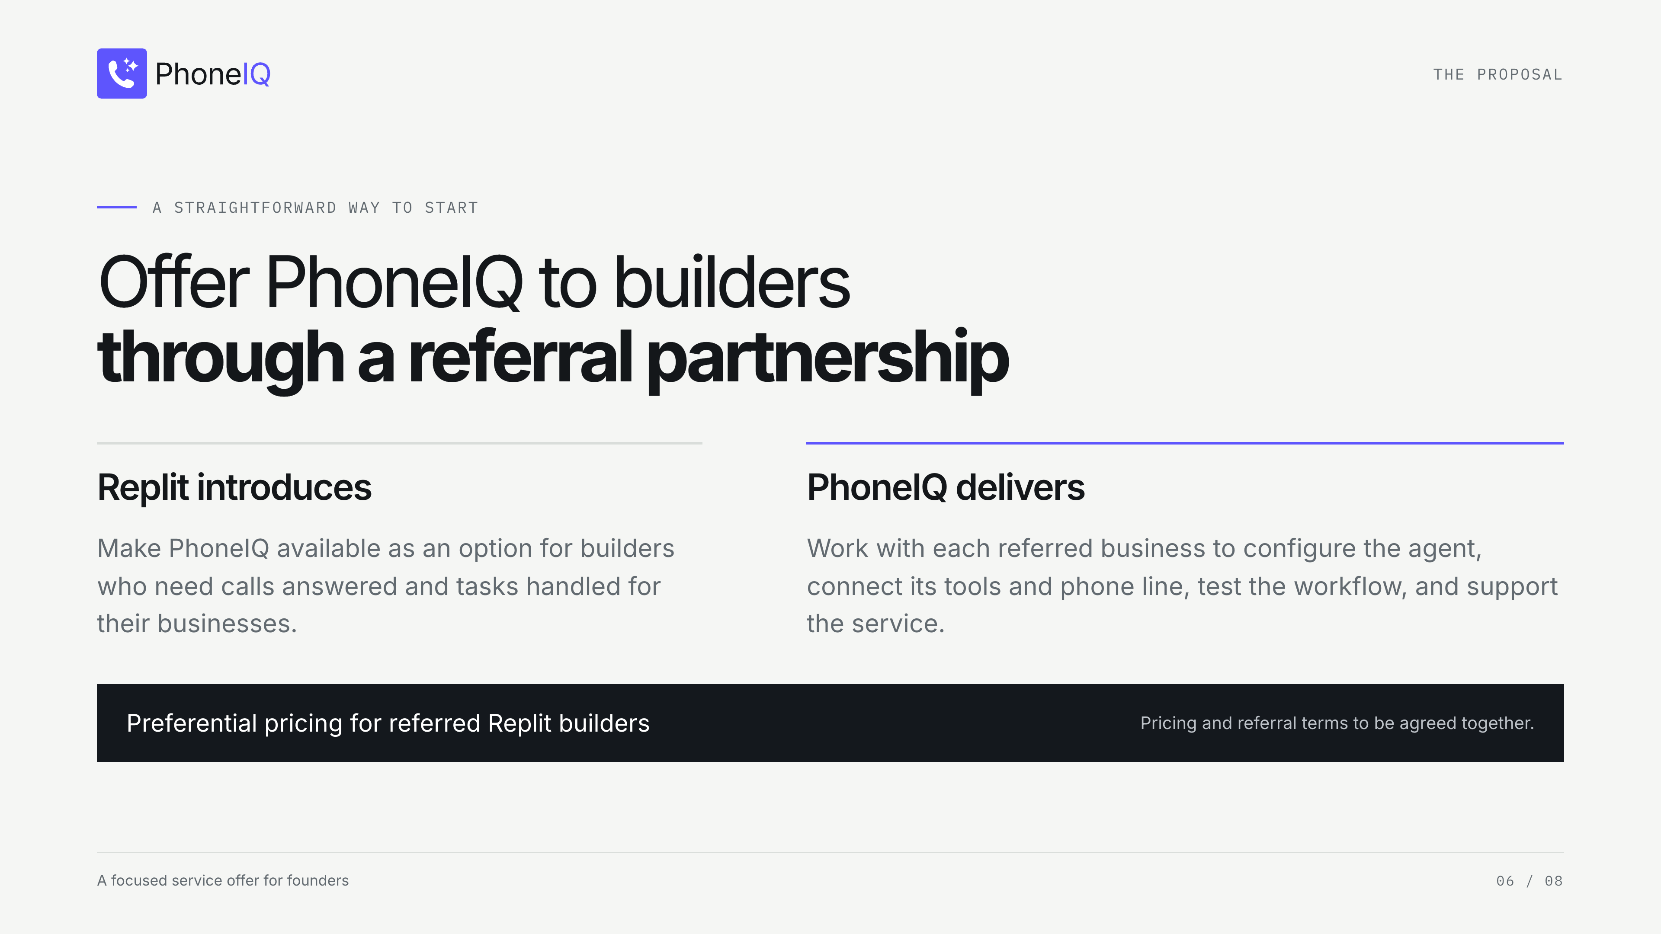
Notes:
[Sources]
- Saliba's brief: referral partnership and a good price for founders building on Replit.
- https://www.phoneiq.co/ (accessed 2026-10-01): configured setup and workflow testing.
- Proposed responsibilities and terms; no accepted partnership, commission, discount, native integration, or Replit endorsement is claimed.

Slide 7
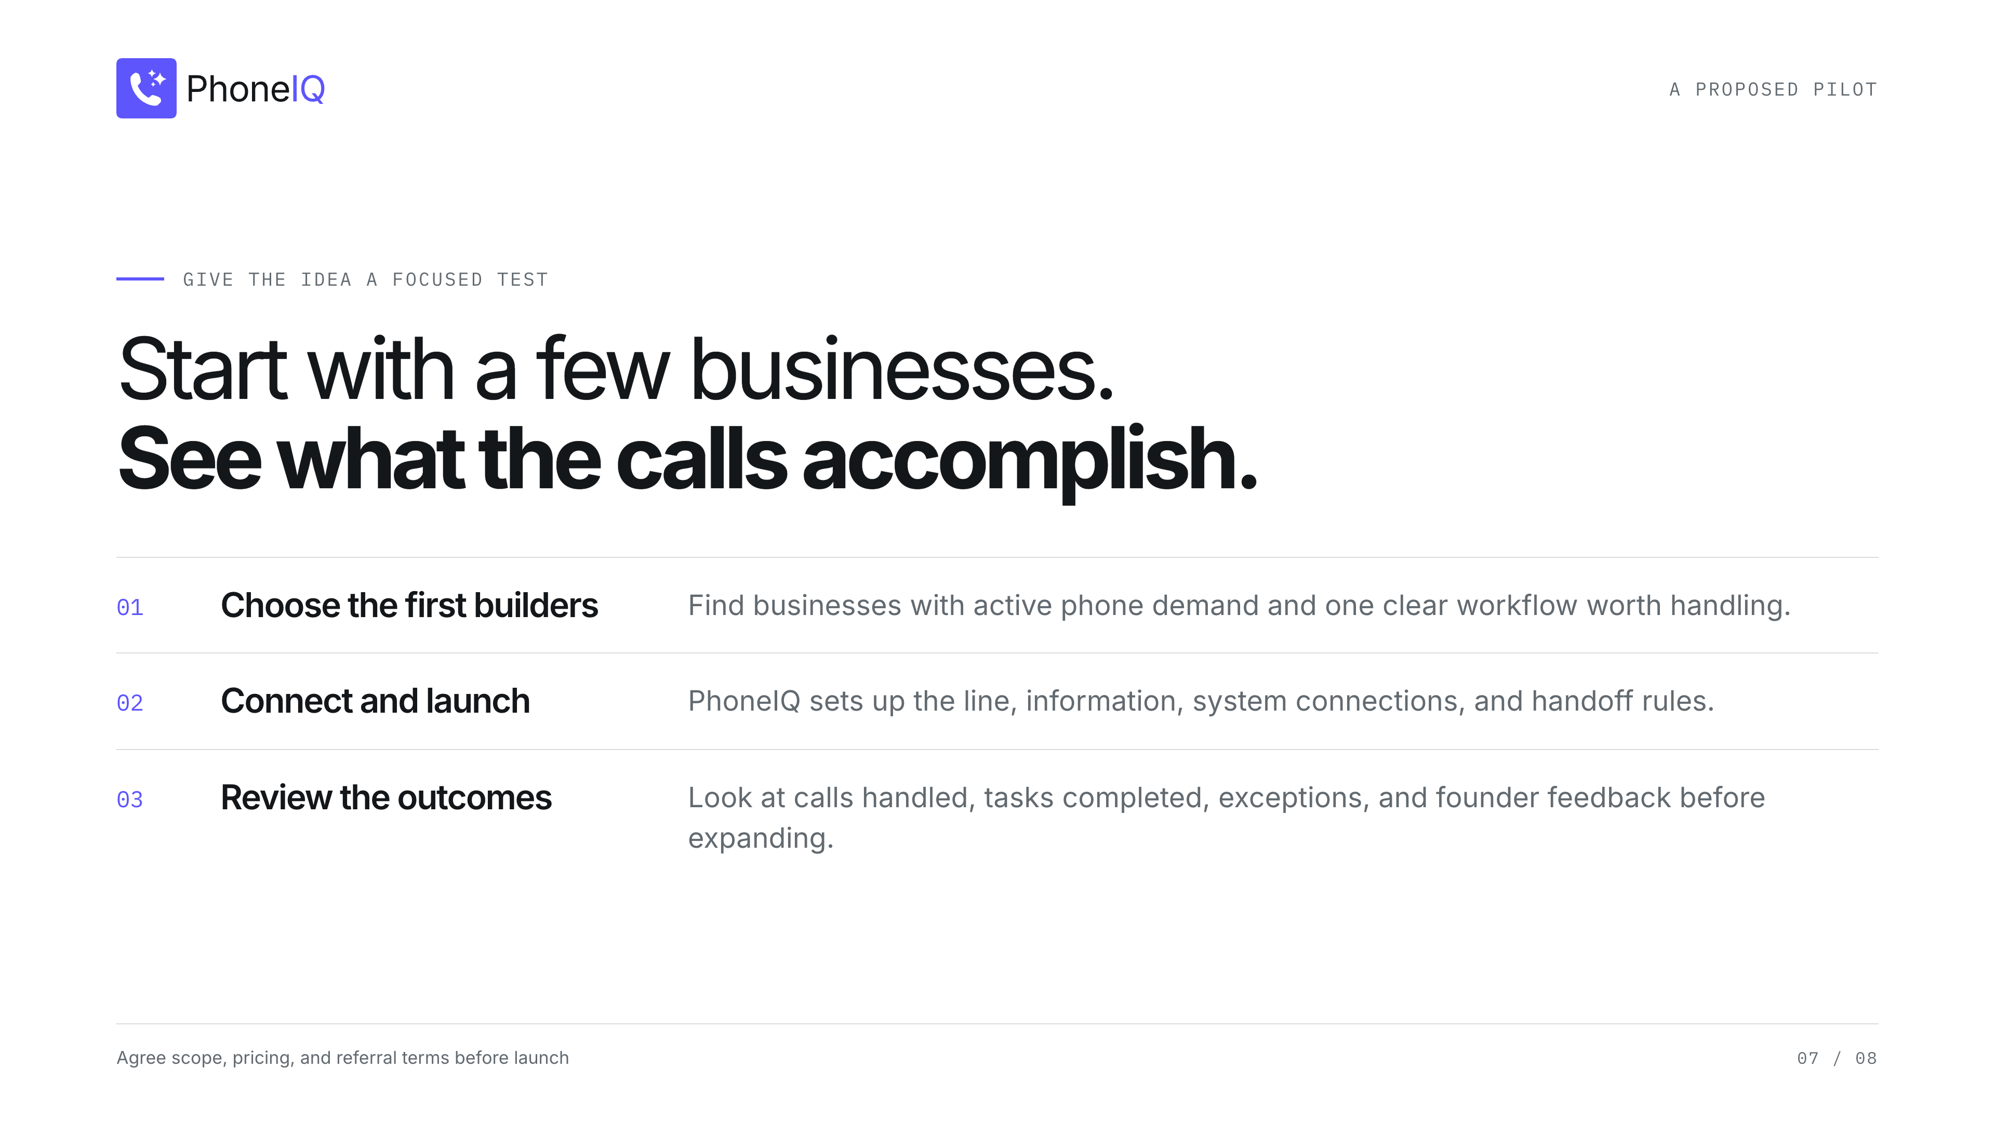
Notes:
[Sources]
- Proposed pilot design developed for this partnership proposal, not a committed or active program.
- Saliba's brief supplies the desired referral model and customer value.

Slide 8
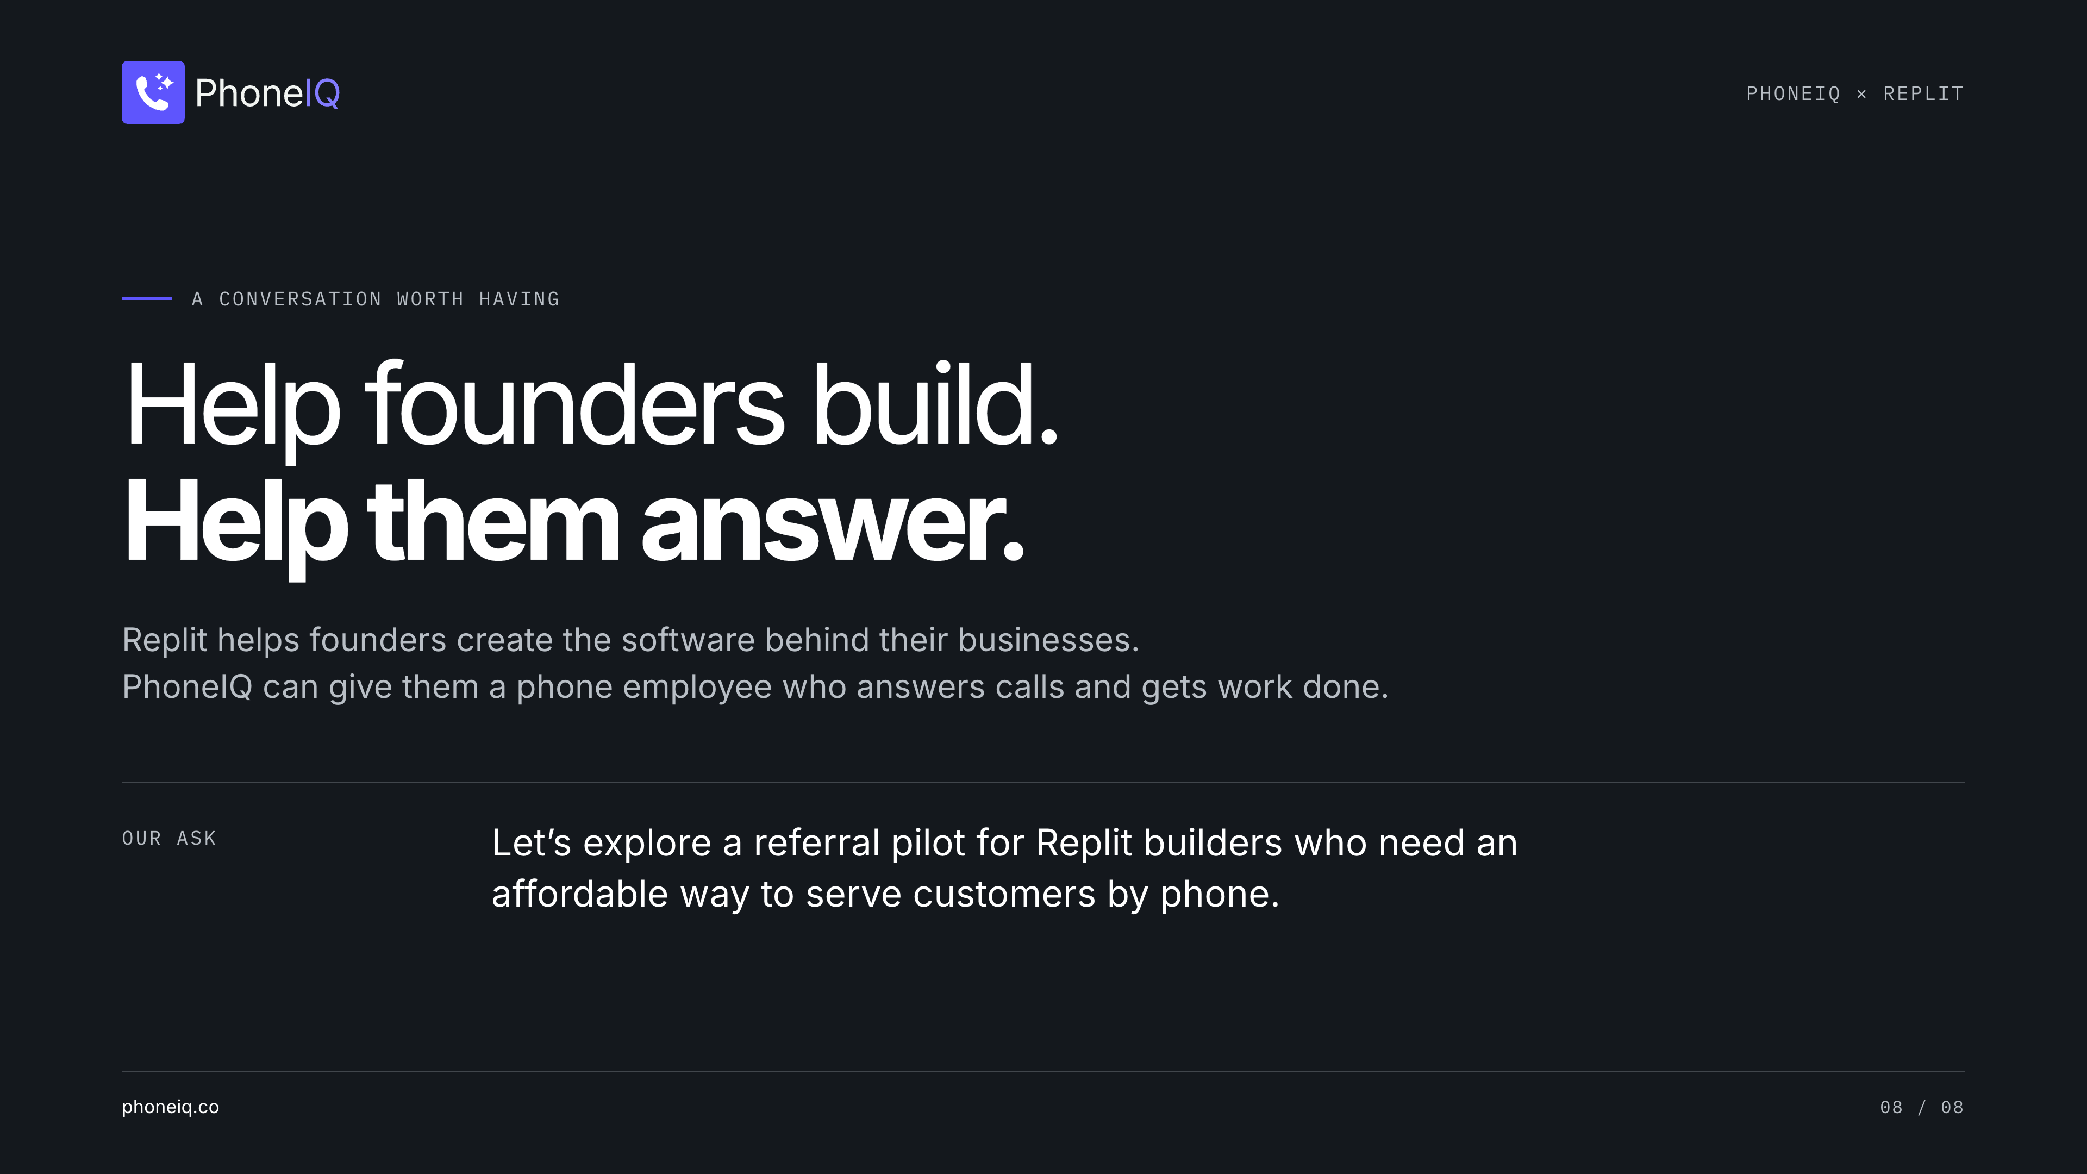
Notes:
[Sources]
- Saliba's partnership brief, 2026-10-01.
- https://replit.com/usecases/smb
- https://www.phoneiq.co/
- This is a proposed partnership. No Replit approval or joint program is implied.

