Slide 1
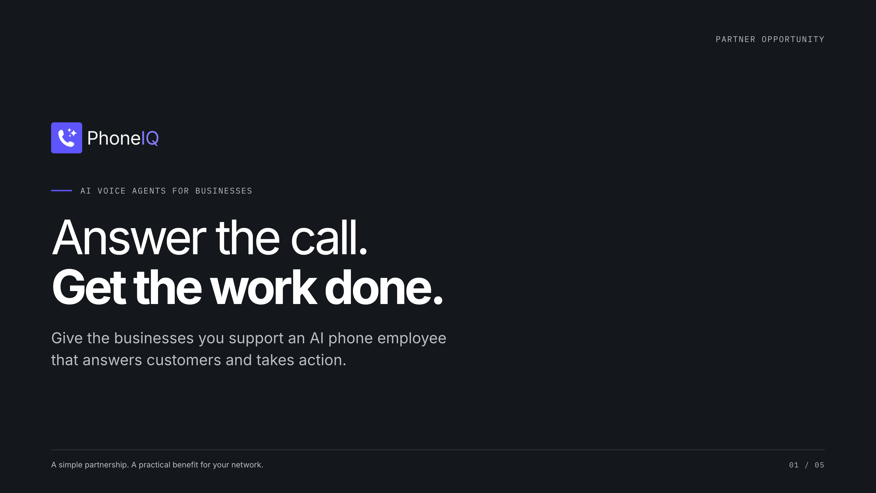
Notes:
[Sources]
- Saliba's supplied brief, October 1, 2026: PhoneIQ connects existing phone lines and business systems; restaurant, salon, and property management examples; discounted partner referral offer.
- https://pebl.com/ and https://pebl.com/expertise/ (reviewed October 1, 2026): PE leadership advisory audience. This is audience context, not a partnership claim.
- https://www.phoneiq.co/brand-guide
- Illustrative workflows depend on configured and tested connections. Partner terms are proposed; no discount amount or performance metric is asserted.

Slide 2
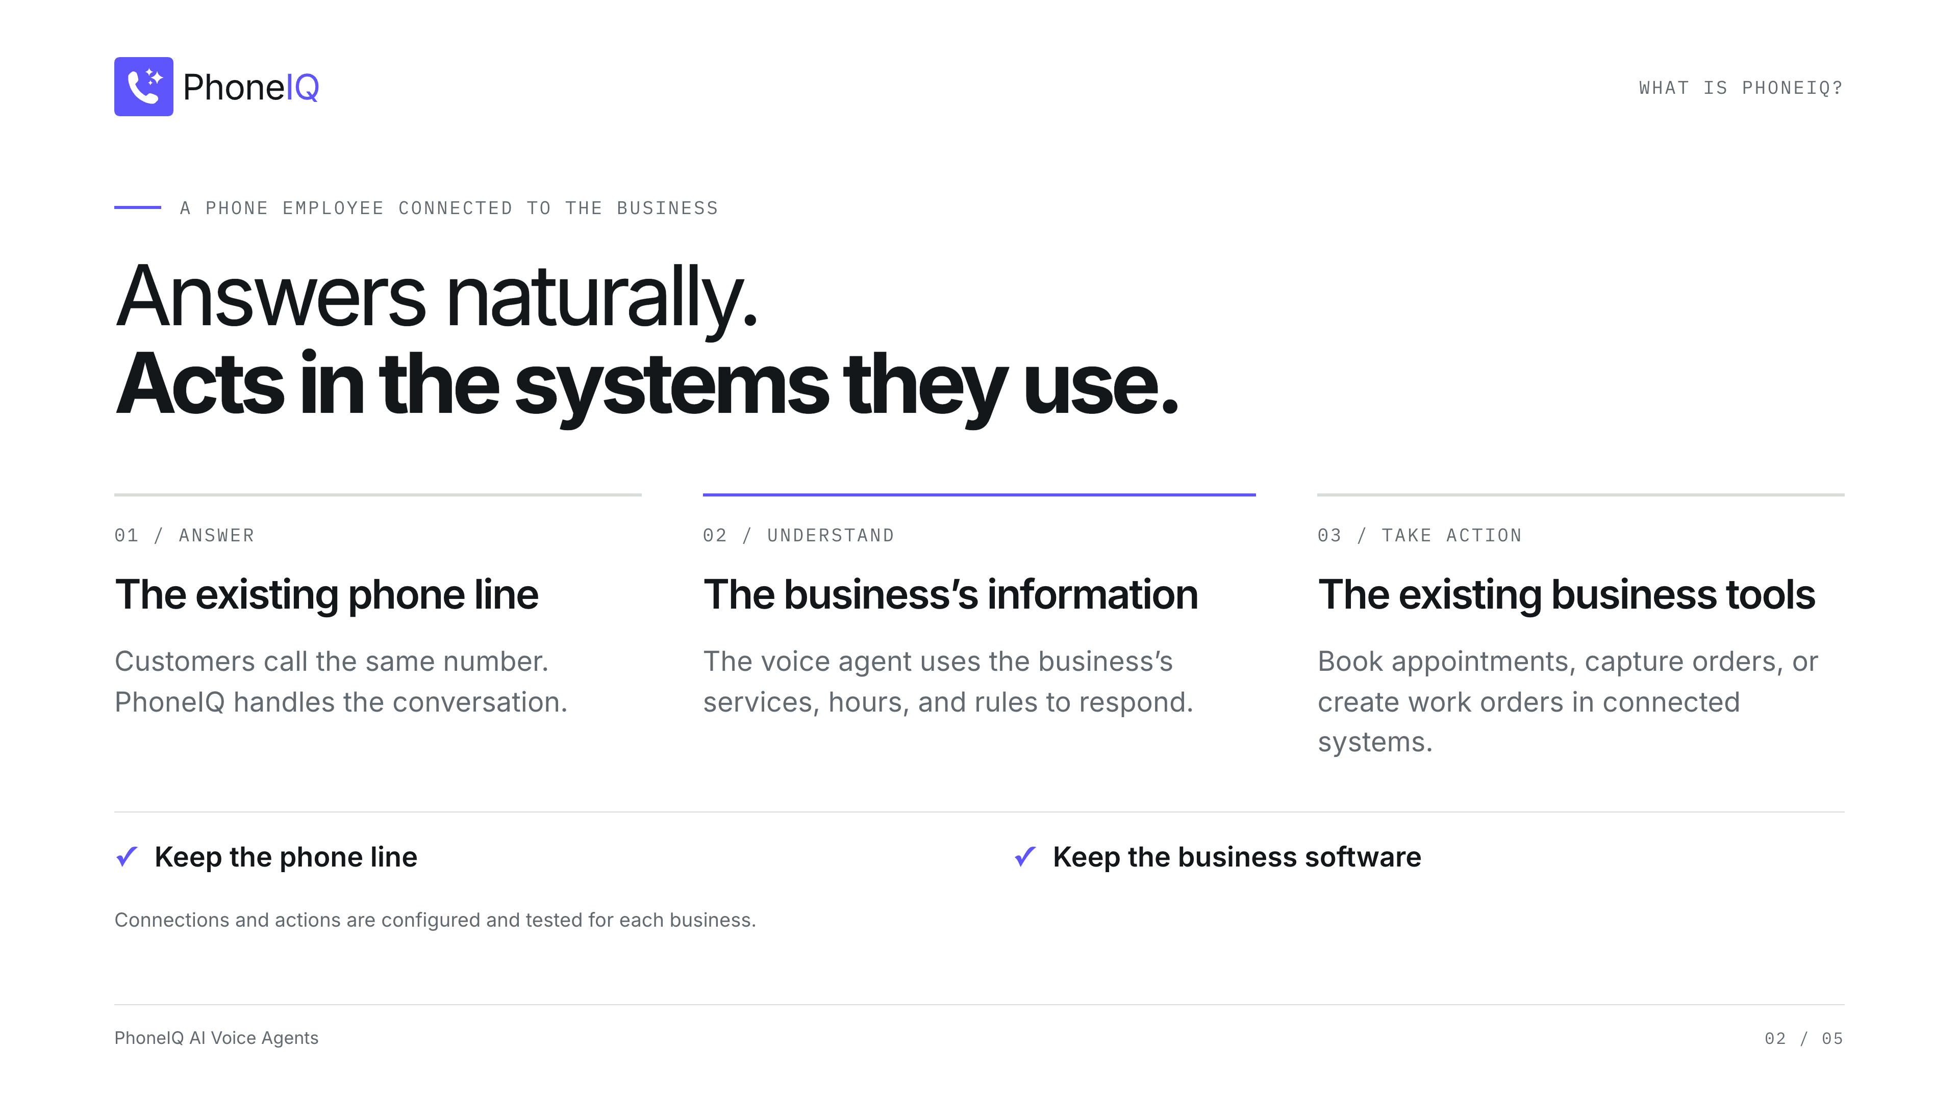
Notes:
[Sources]
- Saliba's supplied brief, October 1, 2026: PhoneIQ connects existing phone lines and business systems; restaurant, salon, and property management examples; discounted partner referral offer.
- https://pebl.com/ and https://pebl.com/expertise/ (reviewed October 1, 2026): PE leadership advisory audience. This is audience context, not a partnership claim.
- https://www.phoneiq.co/brand-guide
- Illustrative workflows depend on configured and tested connections. Partner terms are proposed; no discount amount or performance metric is asserted.

Slide 3
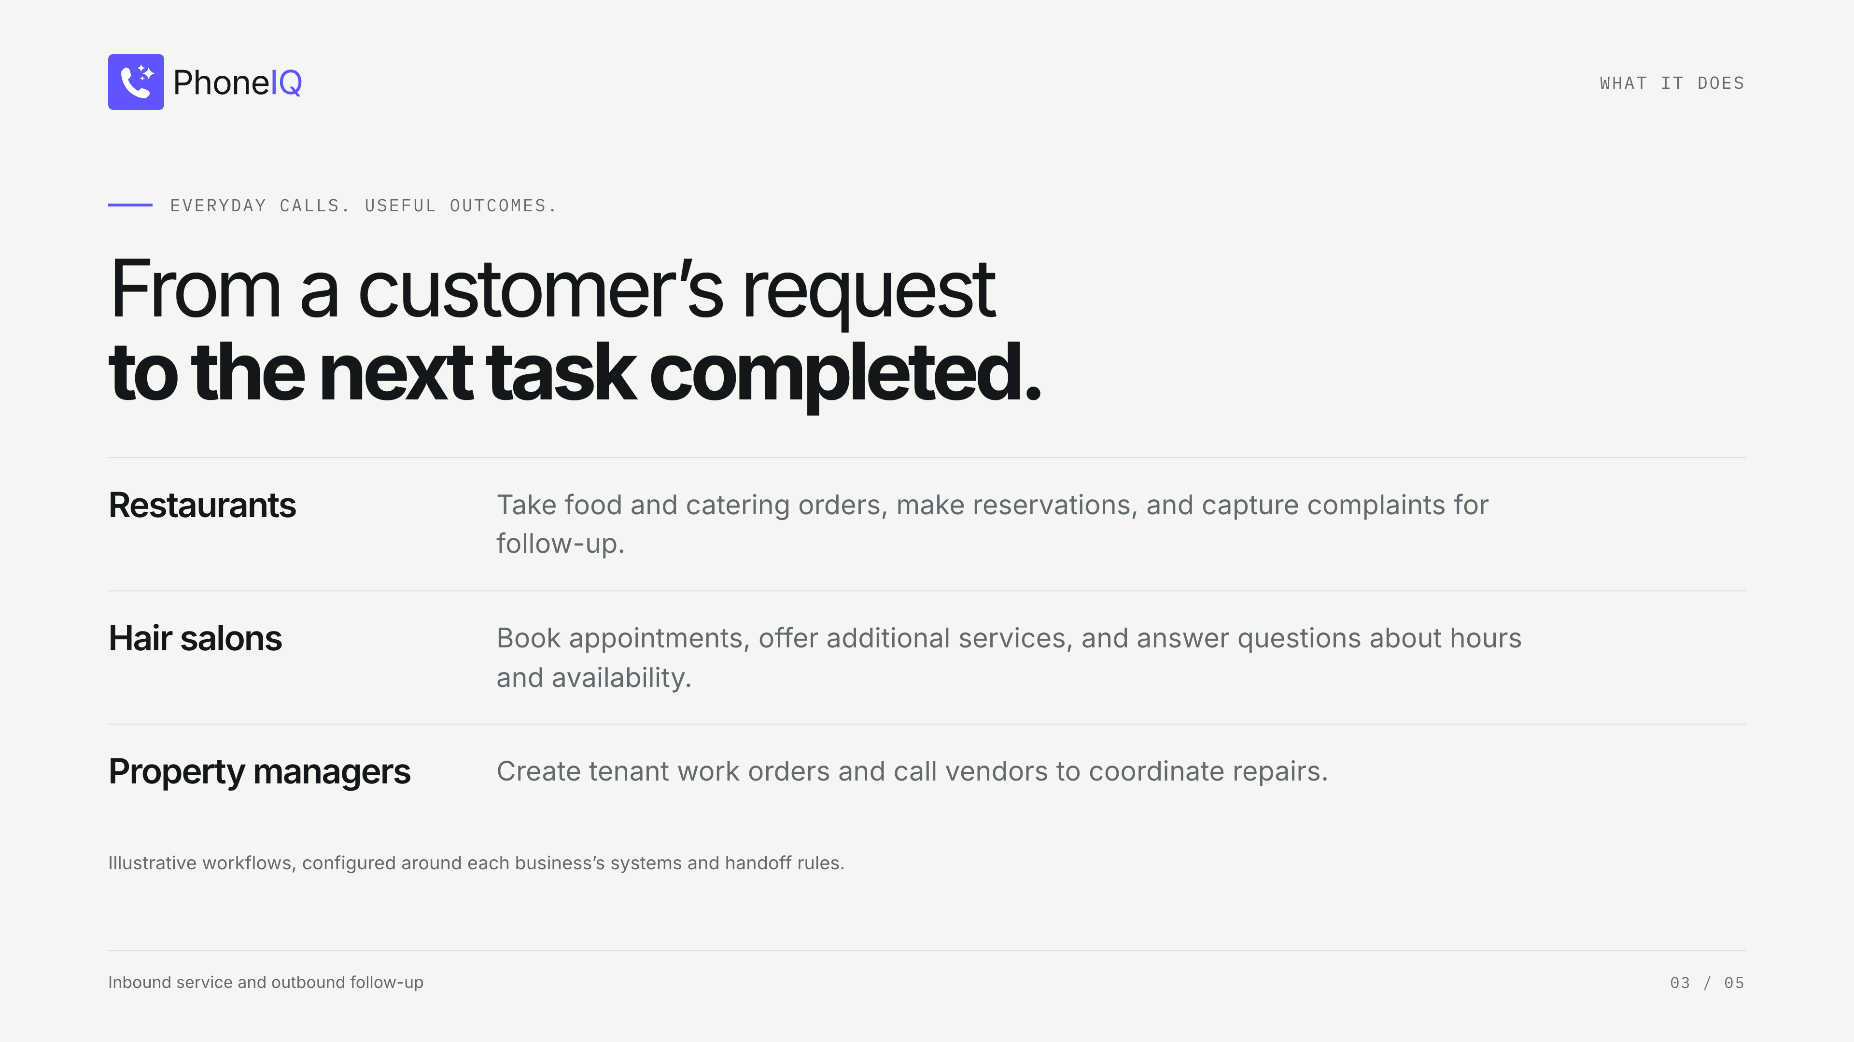
Notes:
[Sources]
- Saliba's supplied brief, October 1, 2026: PhoneIQ connects existing phone lines and business systems; restaurant, salon, and property management examples; discounted partner referral offer.
- https://pebl.com/ and https://pebl.com/expertise/ (reviewed October 1, 2026): PE leadership advisory audience. This is audience context, not a partnership claim.
- https://www.phoneiq.co/brand-guide
- Illustrative workflows depend on configured and tested connections. Partner terms are proposed; no discount amount or performance metric is asserted.

Slide 4
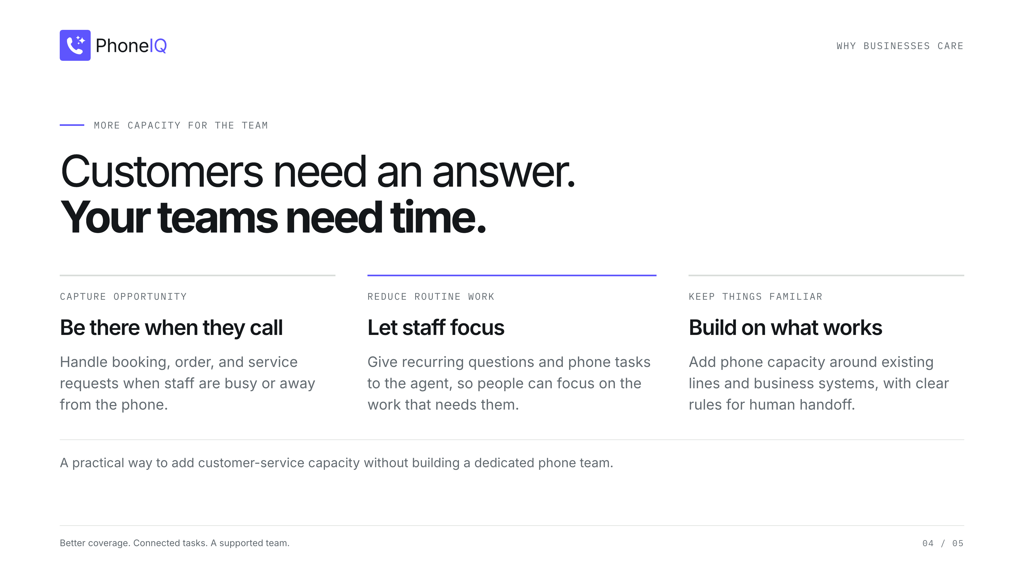
Notes:
[Sources]
- Saliba's supplied brief, October 1, 2026: PhoneIQ connects existing phone lines and business systems; restaurant, salon, and property management examples; discounted partner referral offer.
- https://pebl.com/ and https://pebl.com/expertise/ (reviewed October 1, 2026): PE leadership advisory audience. This is audience context, not a partnership claim.
- https://www.phoneiq.co/brand-guide
- Illustrative workflows depend on configured and tested connections. Partner terms are proposed; no discount amount or performance metric is asserted.

Slide 5
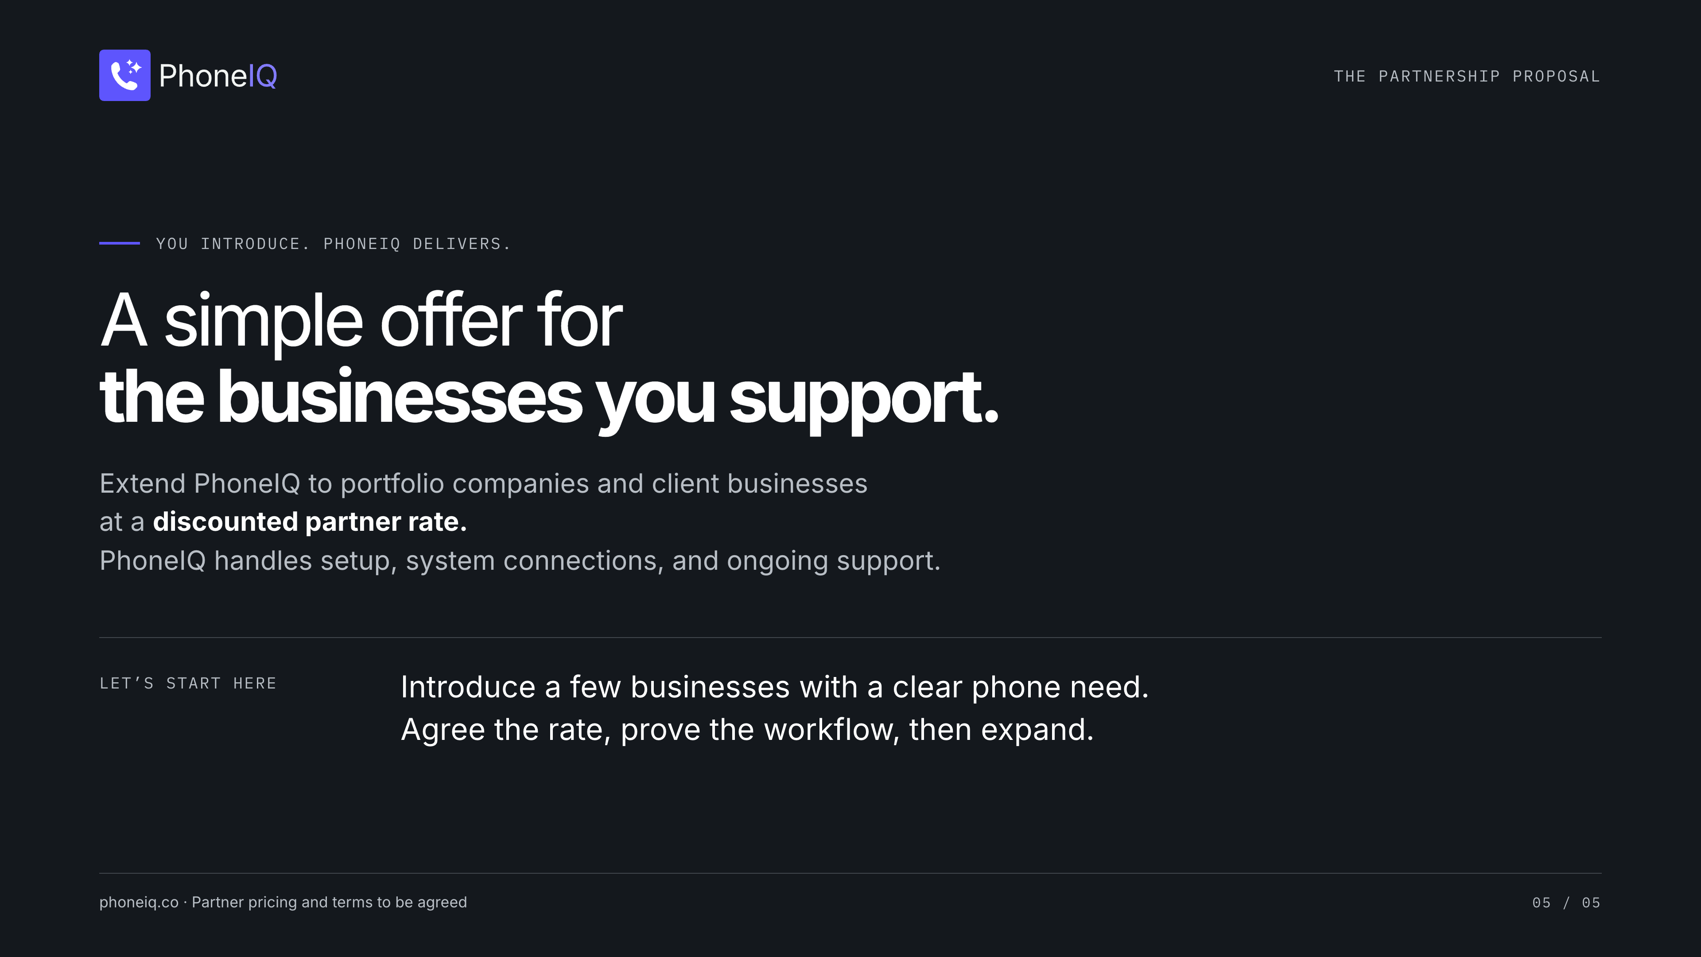
Notes:
[Sources]
- Saliba's supplied brief, October 1, 2026: PhoneIQ connects existing phone lines and business systems; restaurant, salon, and property management examples; discounted partner referral offer.
- https://pebl.com/ and https://pebl.com/expertise/ (reviewed October 1, 2026): PE leadership advisory audience. This is audience context, not a partnership claim.
- https://www.phoneiq.co/brand-guide
- Illustrative workflows depend on configured and tested connections. Partner terms are proposed; no discount amount or performance metric is asserted.

